Slide 1
FiberScout: An Interactive Tool for Exploring and Analyzing Fiber Reinforced Polymers
Johannes Weissenböck¹, Artem Amirkhanov¹, Weimin Li¹, Andreas Reh¹, Alexander Amirkhanov², Eduard Gröller³, Johann Kastner¹, Christoph Heinzl¹
¹ University of Applied Sciences Upper Austria, Wels Campus, Austria
² Ufa State Aviation Technical University, Russia
³ Vienna University of Technology, Institute of Computer Graphics and Algorithms, Austria
Notes:
Good afternoon and welcome to my presentation about FiberScout - An Interactive Tool for Exploring and Analyzing Fiber Reinforced Polymers

Slide 2
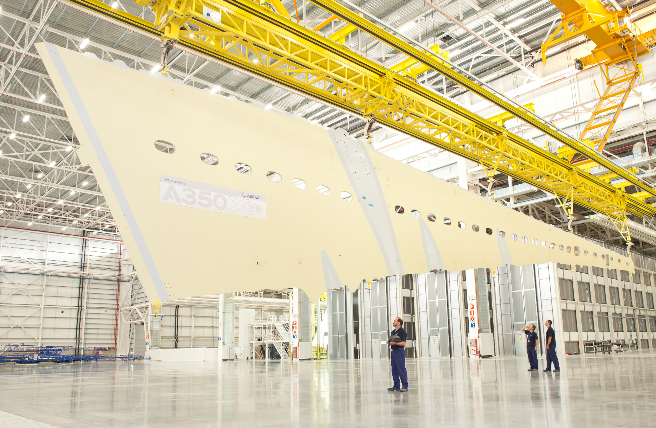
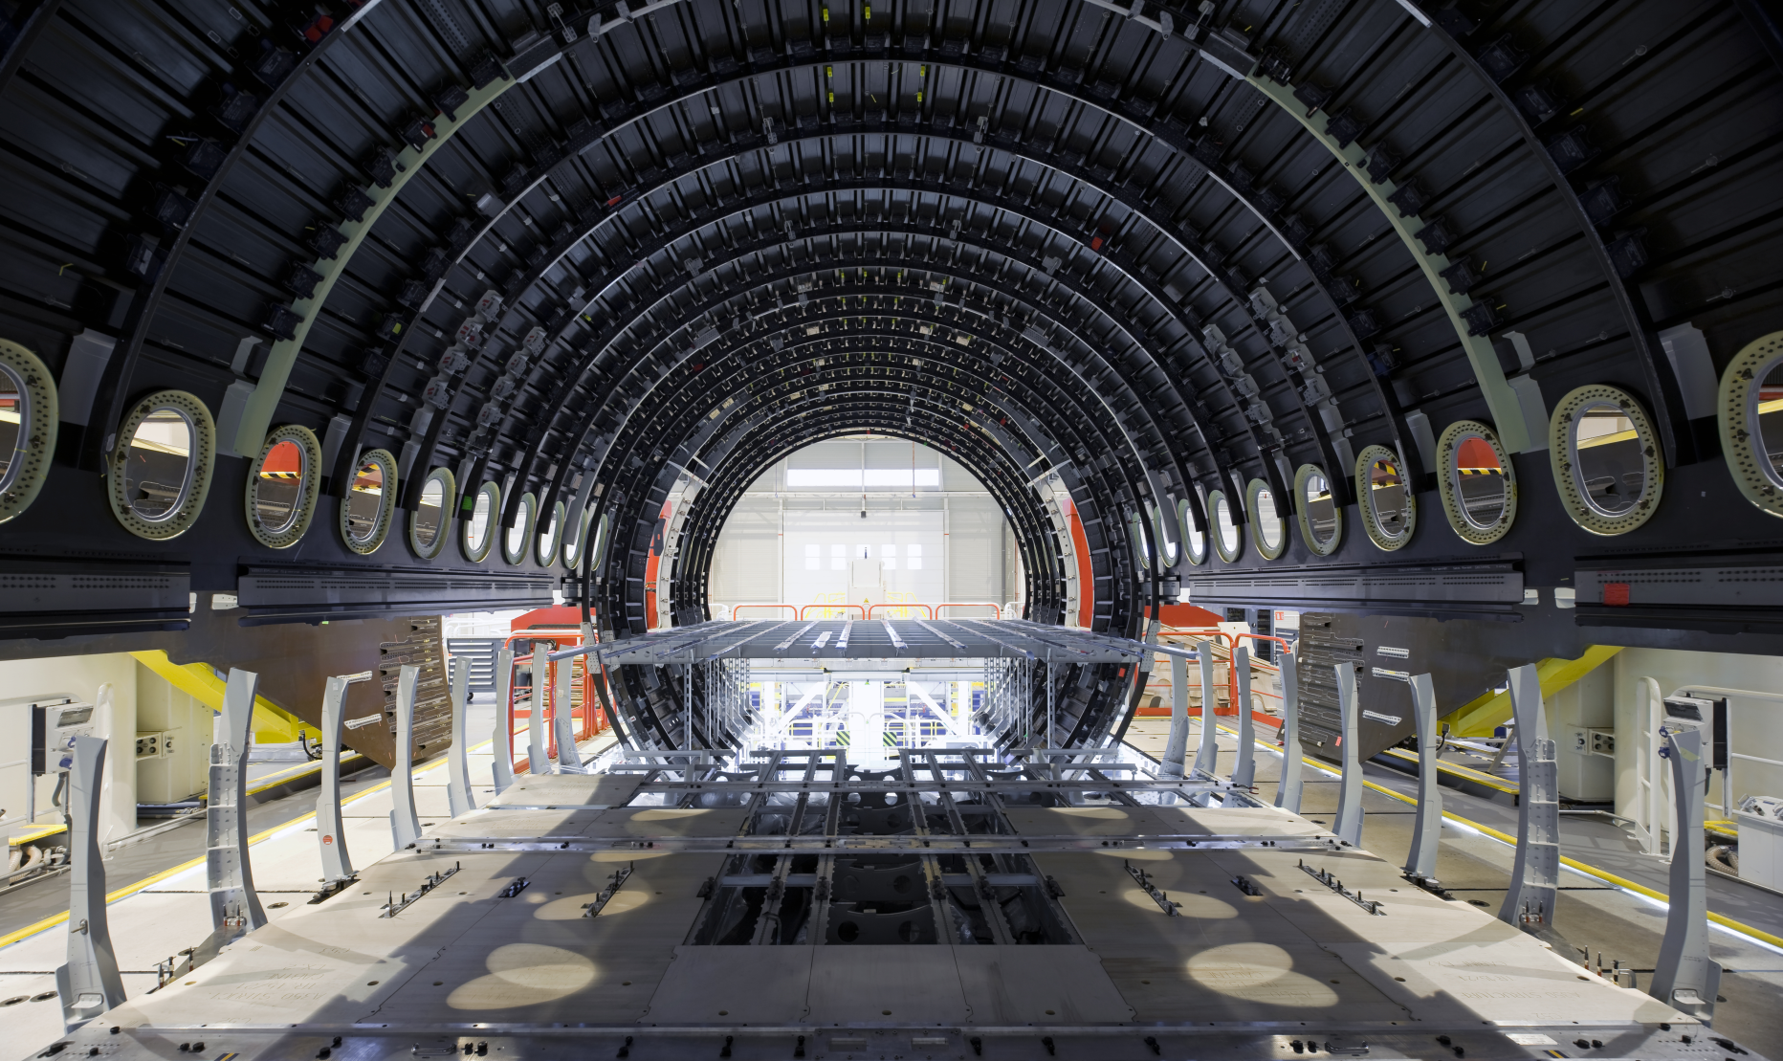
Fiber Reinforced Polymers (FRPs) in Aeronautics
“In next-generation aircrafts, more than 50% of
the complete aircraft will be made of FRPs.”
Jeff Sloan, Composites World
Source: Freudenberg SE, http://www.freudenberg.com/FCOPictureGallery_EN/AirbusA350XWB.jpg
Source: Airbus S.A.S., http://www.a350xwb.com/advanced/fuselage
Notes:
In modern industry there is a clear trend towards new cost-effective, function-oriented, highly integrated and light-weight components.
Especially the aviation industry, but automotive and leasure as well, have found the class of advanced composite materials, which are meeting these requirements.
Advanced composite materials and more specifically fiber reinforced polymers (FRPs) make up a growing proportion in high tech industrial products.
->Zitat
->Bilder: fuselage section, lower cover of a wing

Slide 3
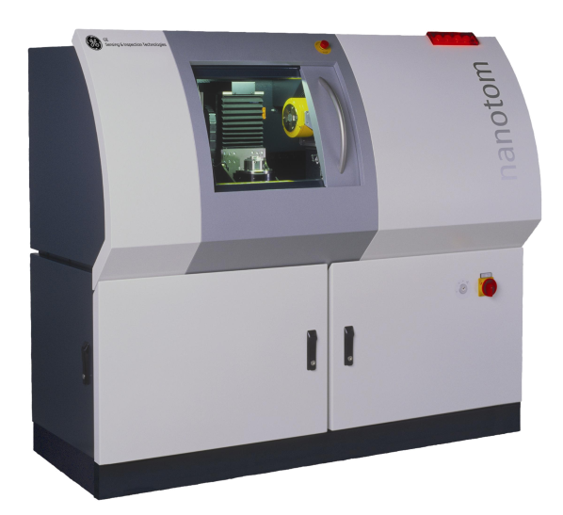
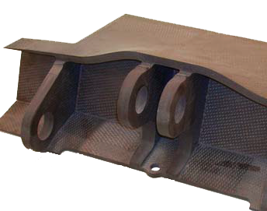
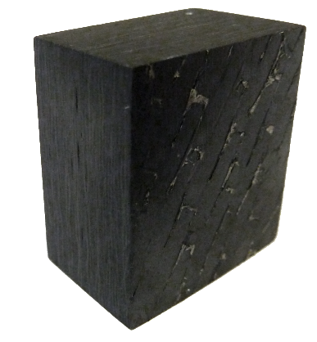
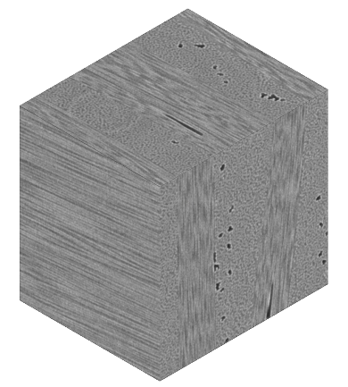
Industrial 3D X-Ray Computed Tomography (3DXCT)
Aircraft component made of FRP
Cutout specimen
3DXCT
Dataset
3DXCT Scanner
Notes:
To analyze aircraft components - Industrial 3D X-Ray computed tomography (3DXCT) is used for non-destructive testing.
With 3DXCT it is possible to get insight into the characteristics of individual fibers without destroying the specimen.
To get our final 3DXCT dataset we have to cutout the specimen ->Zeigen!
…put it in our X-Ray device where we do a high resolution scan …. After reconstructing the scan data we get the final dataset

Slide 4
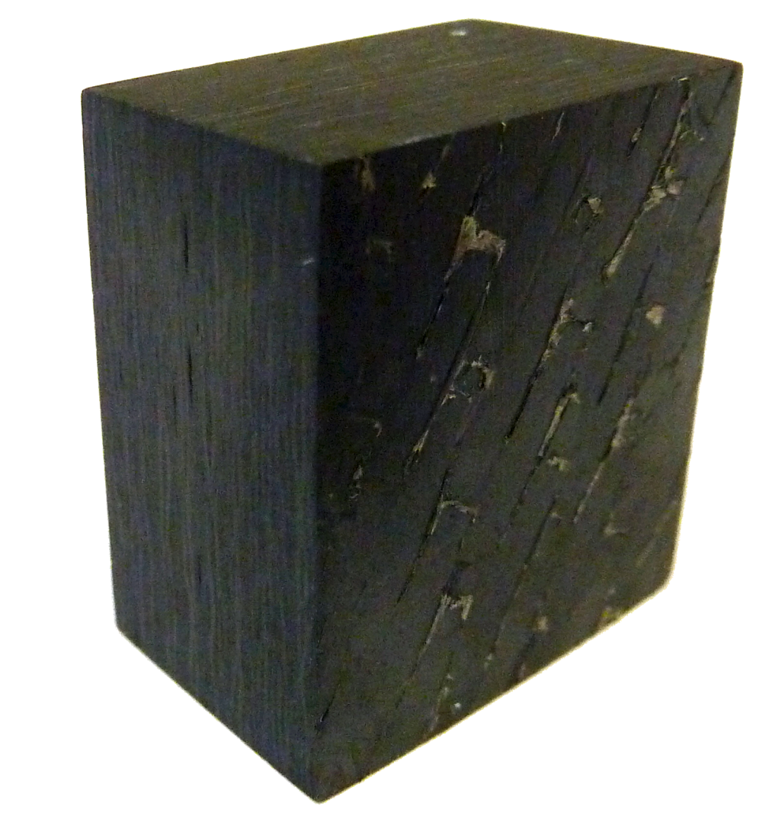
Industrial 3D X-Ray Computed Tomography (3DXCT)
Aircraft component made of FRP
Cutout specimen
3DXCT
dataset
3DXCT scanner

Slide 5
Industrial 3D X-Ray Computed Tomography (3DXCT)
Aircraft component made of FRP
Cutout specimen
3DXCT
dataset
3DXCT scanner

Slide 6
Industrial 3D X-Ray Computed Tomography (3DXCT)
Specimen of a carbon fiber reinforced polymer (CFRP)
Pore
Aircraft component made of FRP
Cutout specimen
3DXCT
dataset
Fibers in
Y-direction
3DXCT scanner
Fibers in
Z-direction
Notes:
This is how a carbon fiber reinforced specimen looks like. With fibers in y-direction and z-direction and pores in it.

Slide 7
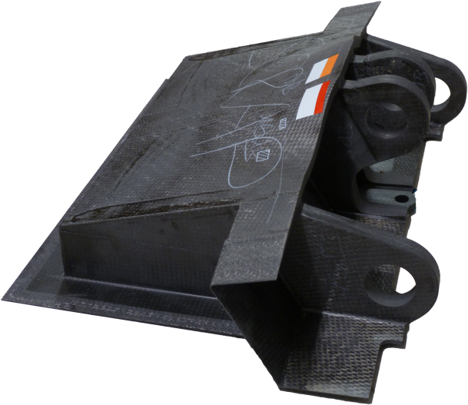
Why are the material experts interested in fibers?
Fibers in
Z-direction
Fibers absorb forces in fiber direction
Fibers determine the material characteristics
3DXCT
dataset
Aircraft component made of FRP
Cutout specimen
3DXCT
dataset
3DXCT Scanner
Fibers in
Y-direction
Notes:
But why are the material experts interested in analyzing the fibers?
-> Fibers absorb the forces in the fiber direction
-> Fibers determine the material characteristics like stiffness, strength and ductility
Important fiber parameters which are influencing the material characteristics are fiber content, fiber length and fiber orientation.
Based on the domain-specific requirements we identified 3 visualization tasks together with the domain experts. With this task it should be possible to better analyze the material. Analyzing the individual fibers with currently available commercial software isn't satisfying.

Slide 8
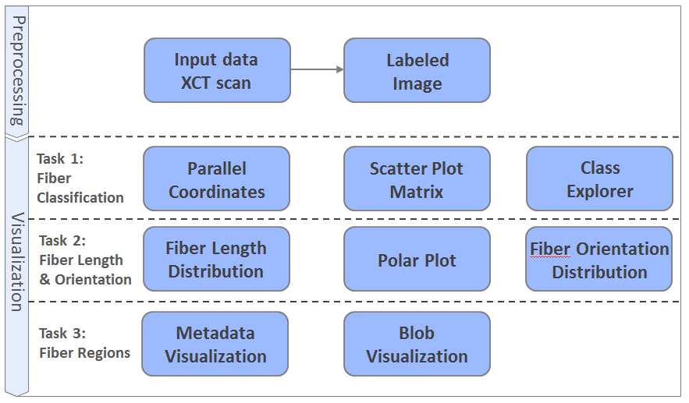
Preprocessing and Visualization Tasks
Notes:
Before I get to the individual tasks we have to perform a preprocessing step.

Slide 9
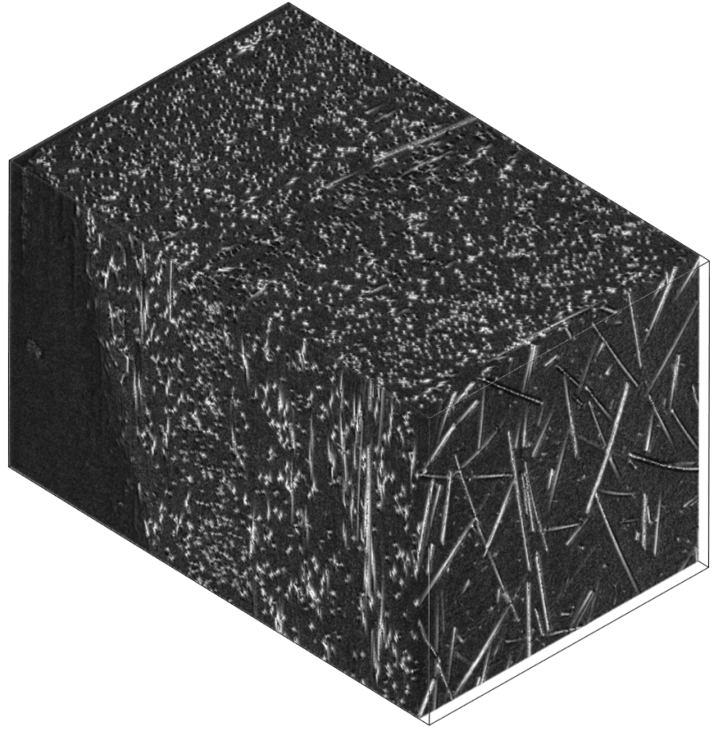
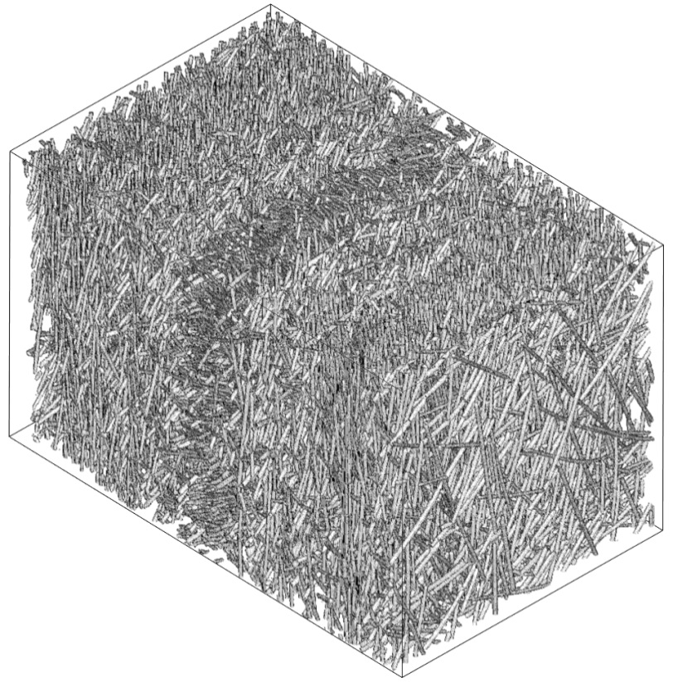
Preprocessing
Specimen of a glass fiber
reinforced polymer
Input: 3DXCT scan
(voxels with gray values)
Output: label image
(voxel with fiberIDs)
Notes:
We take the 3DXCT scan as our input -> in this case a GFRP – where we segment the fibers and get a labeld image as result.

Slide 10
Preprocessing
25 fiber characteristics
Fiber length
Fiber orientation
Average fiber position
…
Output: label image
(voxels with fiberIDs)
Notes:
In addition we calculate 25 fiber characteristics for each fiber like fiber length, fiber orientation, the average fiber position and so

Slide 11
Preprocessing and Visualization Tasks
Notes:
Task 1 Classification of fibers – Is the most important task.
The domain experts need an interactive visualization techniques to define fiber classes according to their specific properties and to render each class.
To do this we use parallel coordinates and a scatterplot matrix to select the individual fibers which we than can add to the class explorer. ->Lets have a look at our GUI.

Slide 12
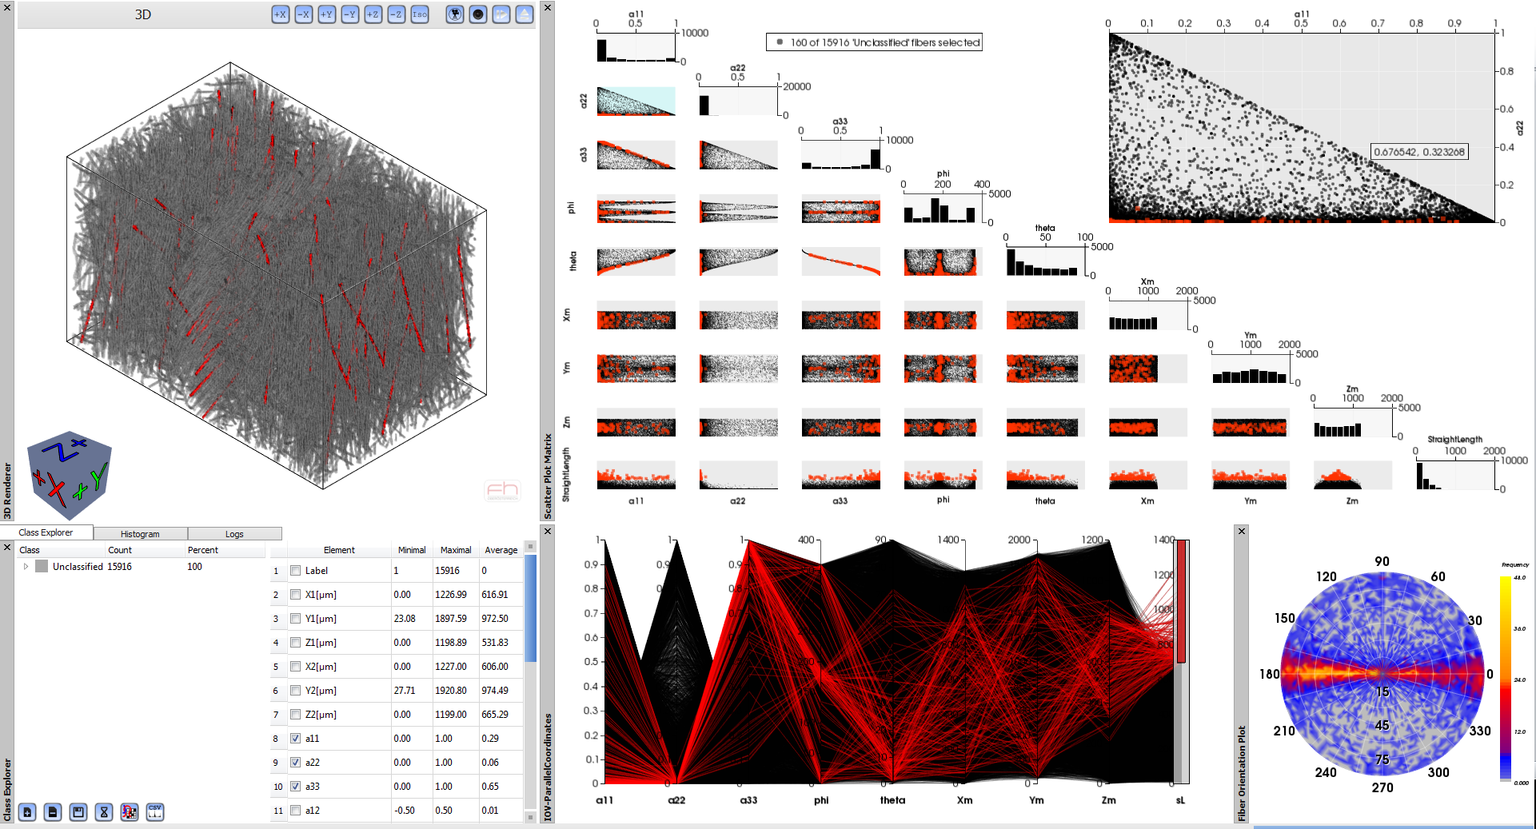
Task 1: Fiber Classification
3D view
Scatter plot matrix
Class explorer
Parallel coordinates
Polar plot
Notes:
Top left: 3D rendering view with the 3D dataset
Top right: the scatterplot matrix with the fiber characteristics
Bottom Left: The Polar Plot – For identifying the fiber orientations. I will tell you more about it later on.
Here u can see Parallel Coordinates – which is linked with the scatterplot and the 3D view
The Class explorer: where we can add our defined fiber classes an have a look at some statistics.

Slide 13
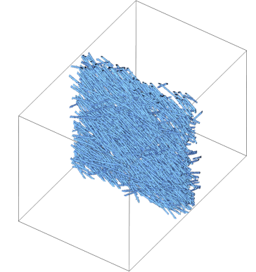
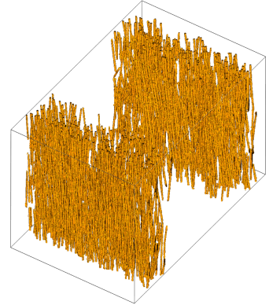
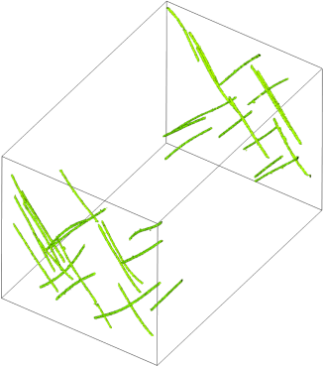
Task 1: Fiber Classification
Class 1
Class 2
Class 3
Class Explorer
Notes:
Now, I will now u a video how the classification of fibers is done.

Slide 14
Preprocessing and Visualization Tasks
Notes:
Fiber Length and Orientation contribute to a large extend to the final material characteristic such as stiffness and strength.

Slide 15
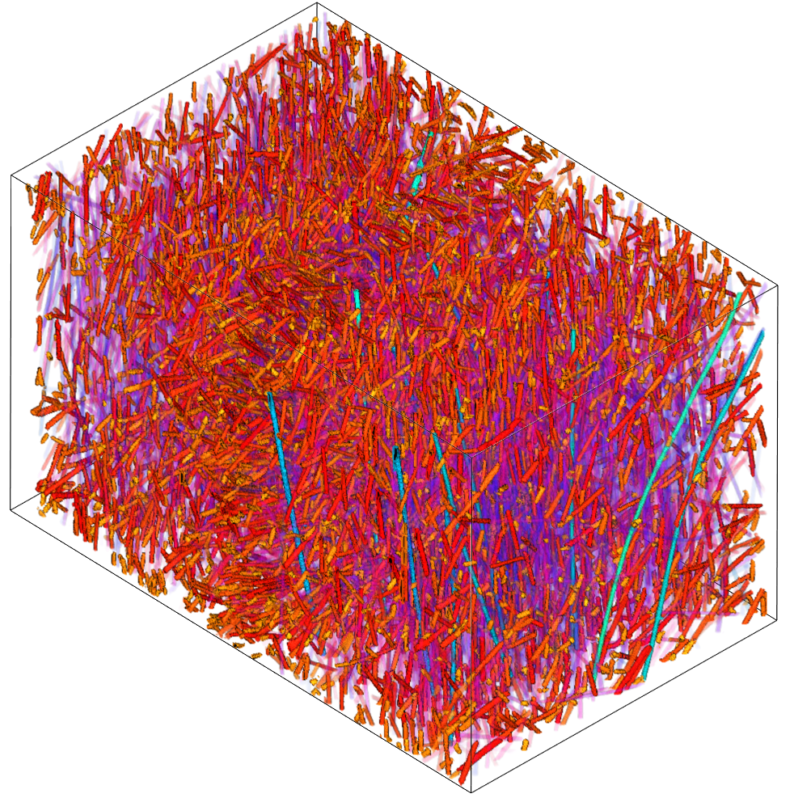
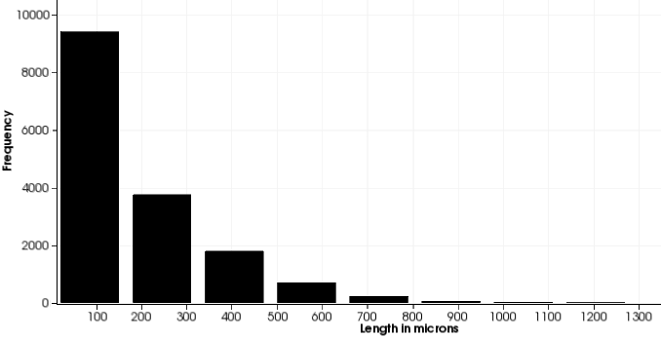
Task 2: Fiber Length Distribution
Fiber Length Distribution
Frequency
Length in microns
Notes:
Therefore we provide the domain experts with the fiber length distribution visualization. Where the fibers a colored-coded according to their length.
Cause of the fact that long fibers and short fibers are more important we made them less transparent than fibers with a mean length.
We also provide a diagram for fiber length distribution.

Slide 16
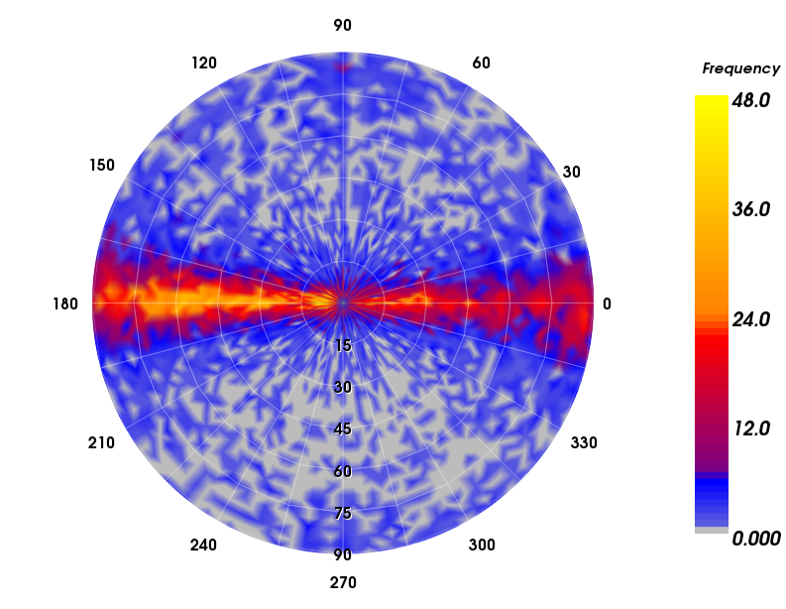
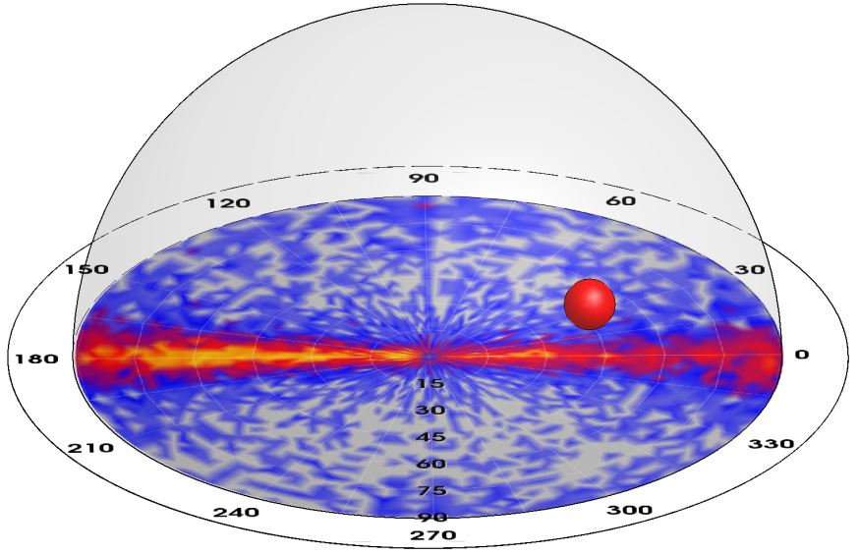
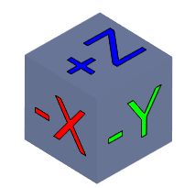
Task 2: Polar Plot
Fibers oriented along X-axis,
tilted to Z-axis (30° - 75°)
Frequency
Z
(X, Y, Z)
θ
r
X
φ
Y
Specimen with unclassified fibers
Corresponding
polar plot view
Notes:
As shown before, we implemented the polar plot to give the domain experts a quick overview of the fiber orientations in the specimen. The polar plot is calculated for every new defined class.
For constructing the polar plot we transform the Cartesian coordinates of the fibers into polar coordinates.
The angle Phi defines the rotation of the fiber to Z-axis.
The angle Theta defines the tilt to the Z-axis.
We then color-code the orientation frequencies of the fibers.
For the marked area the fibers….

Slide 17
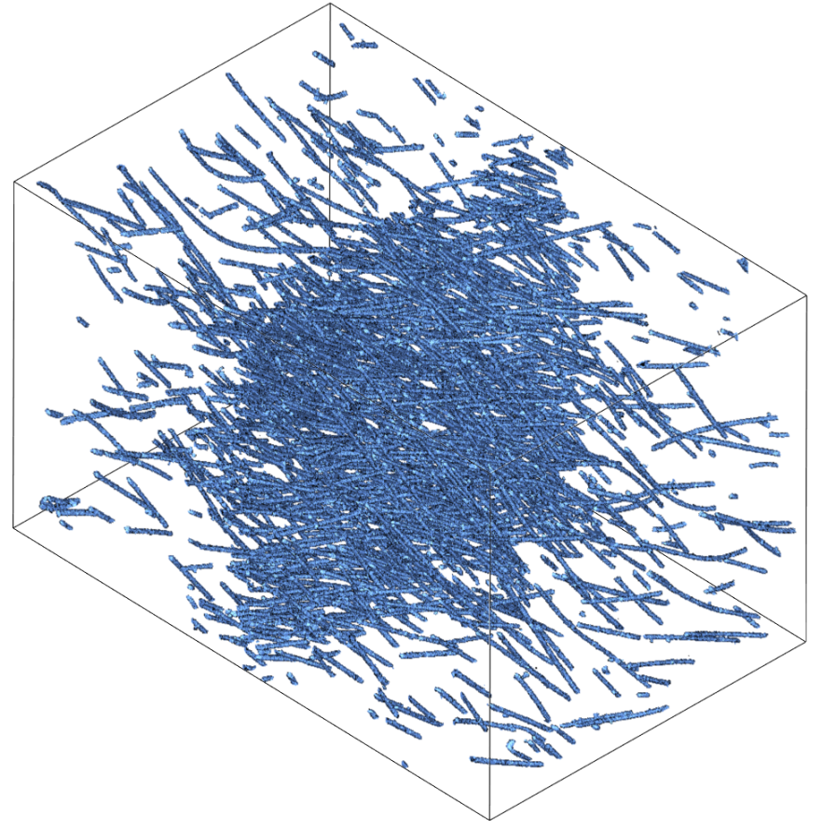
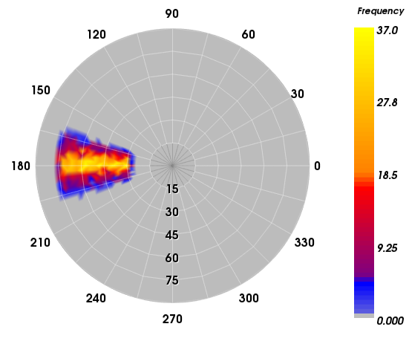
Task 2: Polar Plot
Fibers oriented along X-axis,
tilted to Z-axis (30° - 75°)
Frequency
Specimen with classified fibers
Corresponding
polar plot view
Notes:
If we define a fiber class with such characteristics the class would look like this.

Slide 18
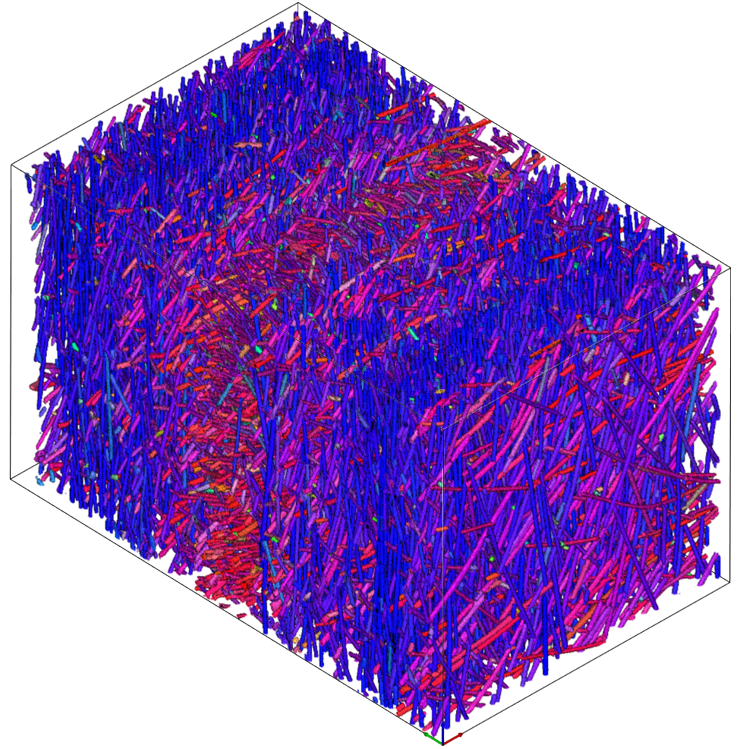
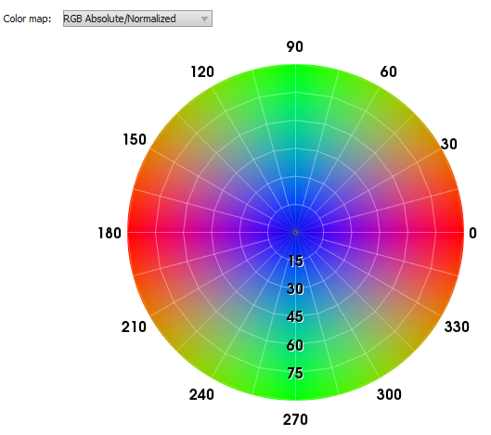
Task 2: Fiber Orientation Distribution
Corresponding color map
Notes:
Another part of task 2 is the fiber orientation distribution visualization.
The fibers are color codded according to the color map on the right. Where fibers in Z-direction are shown in blue, fibers in X-direction are shown in red and fibers in Y-direction are shown in green.
With the fiber orientation distribution domain experts can quickly identify layers within the specimen.

Slide 19
Preprocessing and Visualization Tasks
Notes:
For Task 3 ‘Fiber Regions’ we implemented Metadata Visualization and blob visualization.

Slide 20
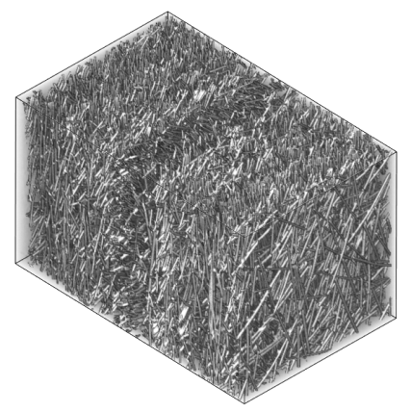
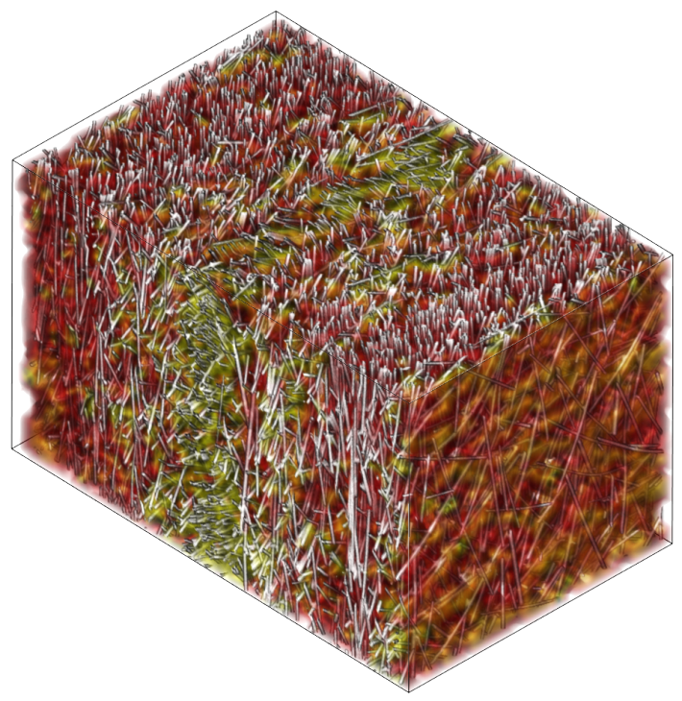
Task 3: Metadata Visualization
Average fiber characteristics of all the fibers within a cell
For example: fiber characteristic θ
θ ≈ 0°:
Fibers are almost
aligned to the Z-axis
θ ≈ 90°:
Fibers are almost
aligned to the XY-plane
Metadata visualization of our software
3D volume
Subsampled
3D volume
Notes:
With the metadata visualization the domain experts can quickly get an rough overview of specific fiber characteristics.
Therefore we subsample the 3D volume with a user defined voxel size. We then calculate the average fiber characteristic of all the fibers within a cell and color-code these values. After that we overlay the 3D volume with the metadata volume.
For example: fiber characteristic theta …
The final metadata visualization of our software looks like this. The red area shows that fibers are orientated….

Slide 21
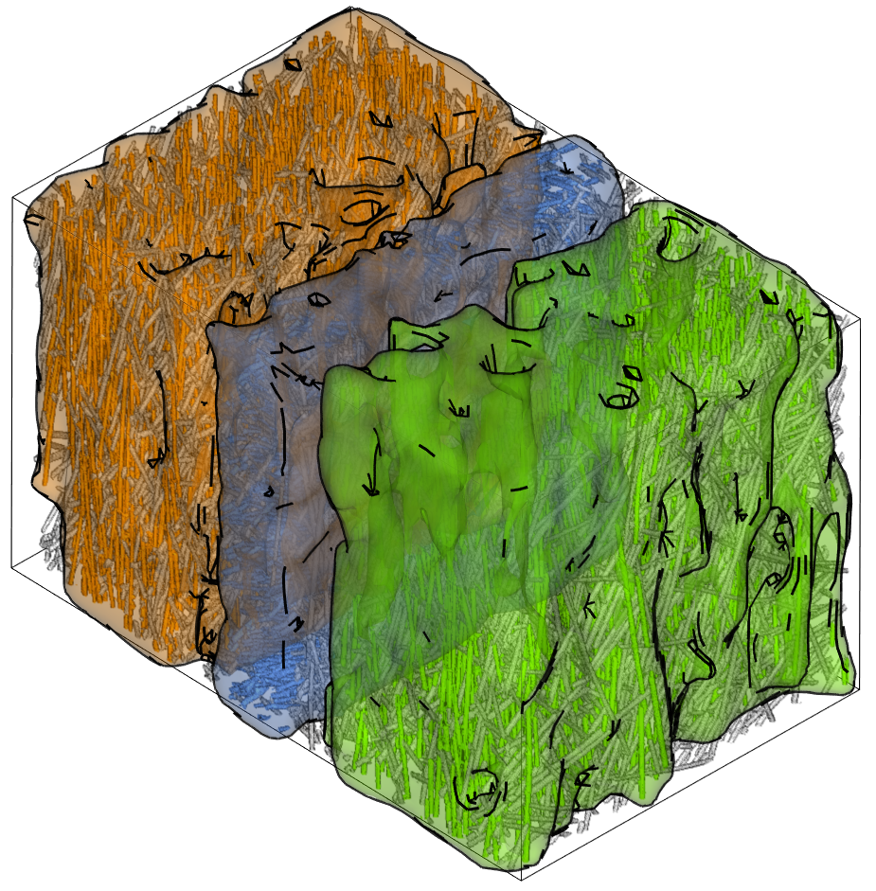
Task 3: Blob Visualization
Notes:
The blob visualization addresses the problem of cluttering and occlusion.
It gives the domain experts the possibility to put a hull around each defined fiber class with similar fiber characteristics.
With this visualization it is easy the see the different fiber regions.

Slide 22
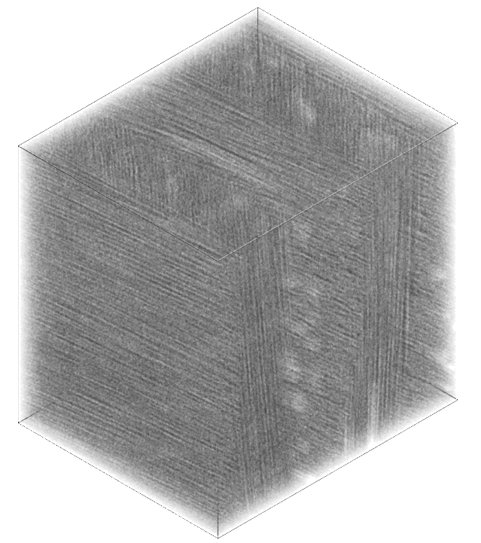
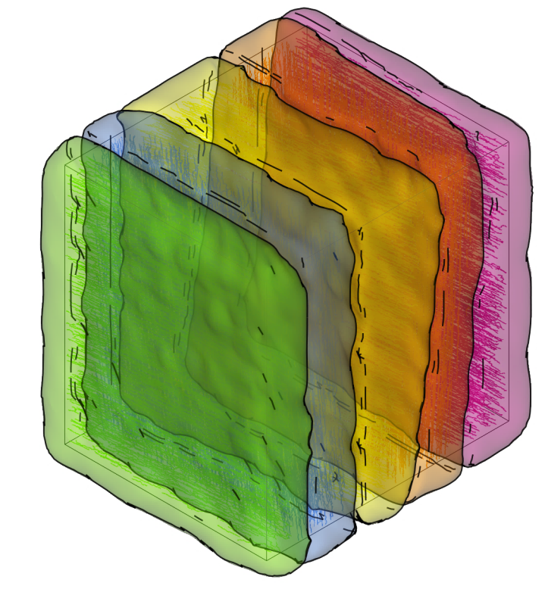
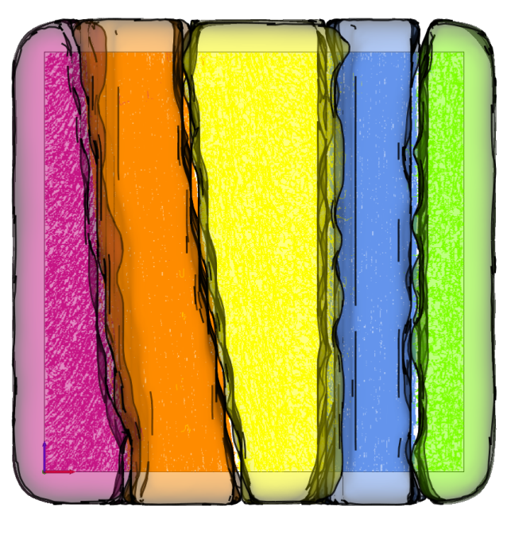
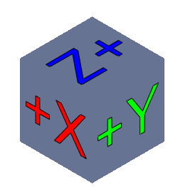
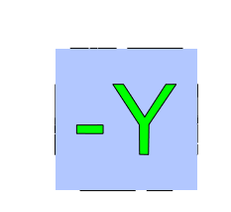
Task 3: Blob Visualization
Notes:
Here another example with carbon fiber reinforced specimen on the left. In the middle the blob visualization where we can identify the different layers. And on the right the y-plane of the blob visualization where we can se the regions.

Slide 23
Evaluation: Domain Experts Feedback
Overall positive feedback
Likes & Dislikes:
+ Brushing & linking
+ Scatter plot matrix best for clustering fiber characteristics
+ Main fiber orientation with the polar plot
+ Metadata visualization to quickly explore the data
- Outlier detection using the blob visualization
Notes:
We also did a user evaluation with 8 domain experts (four of them come from the field of NDT and the other four are material scientists).
Therefore we designed an evaluation questionnaire which addresses the 3 visual Tasks.
We overall got positive feedback from them.
They liked the concept of B & L… they pointed out that the scatter plot matrix is best for clustering fiber characteristics. They liked the polar plot to get the main fiber orientation and they liked the metadata visualization to quickly explore the data.
On the other hand they marked that they did not like the blob visualization for outlier detection.

Slide 24
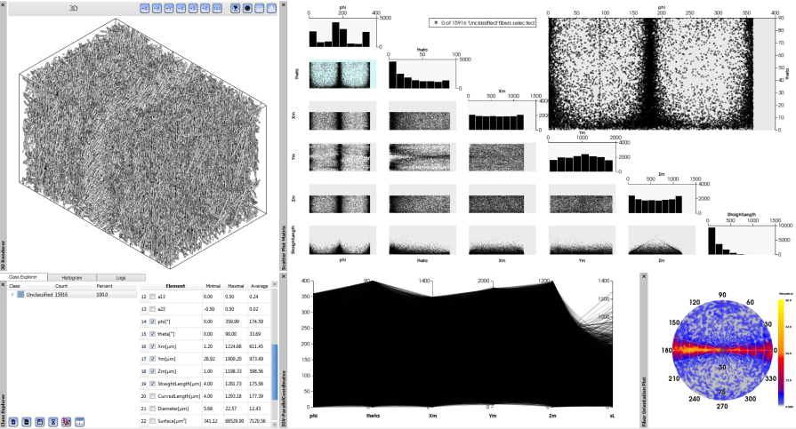
Conclusion
FiberScout, a visualization system for visual
analysis of fiber characteristics in FRPs
Task1: Classification of fibers:
parallel coordinates
scatter plot matrix
class explorer
Notes:
Let me conclude my talk – We presented FiberScout...
Together with the domain experts we identified 3 Tasks – Task1…We used PC SPM and the class explorer to solve this task.

Slide 25
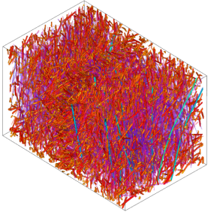
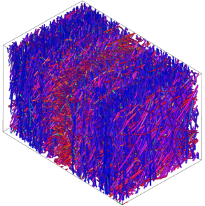
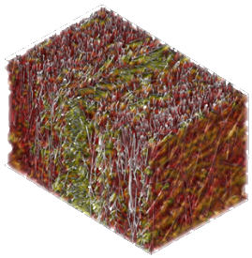
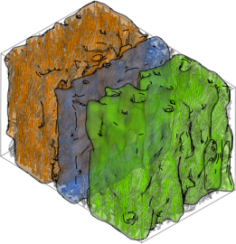
Conclusion
Task 2: Visualization of fiber lengths and orientations:
fiber length distribution
fiber orientation distribution
polar plot
Task 3: Visualization of fiber regions:
metadata visualization
blob visualization
Notes:
For solving Task2 … we used the fiber length & orientation distribution and the polar plot
For visualizing fiber regions we introduced metadata and blob visualization.

Slide 26
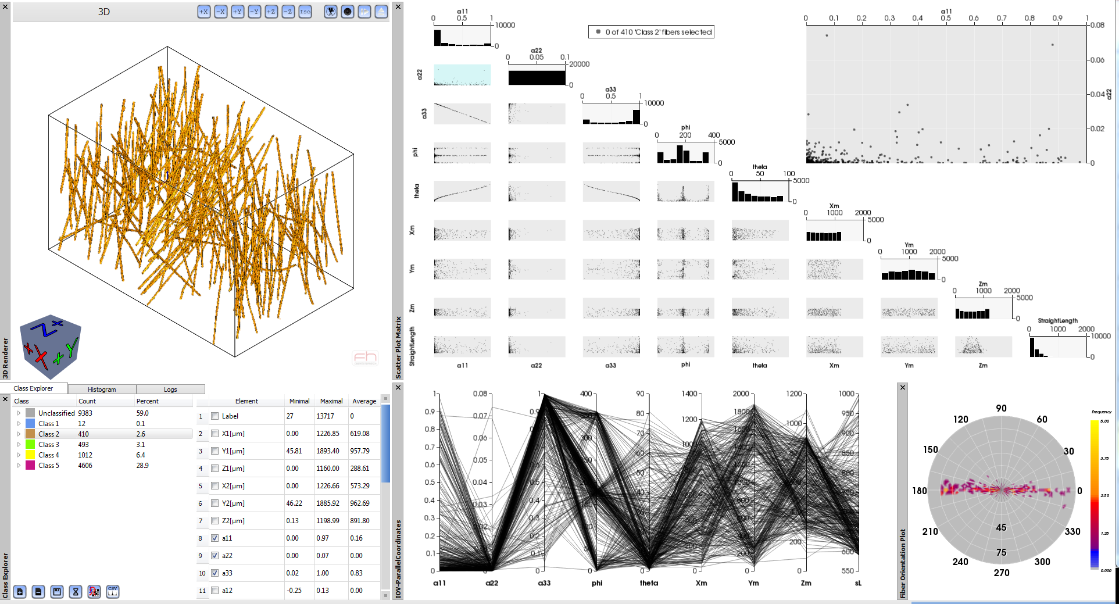
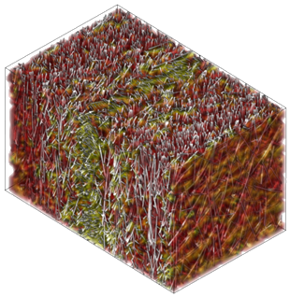
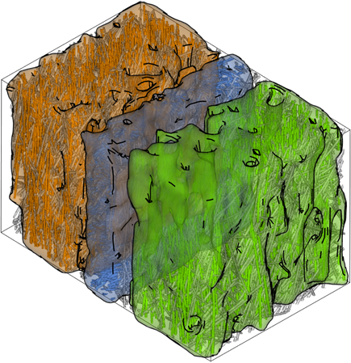
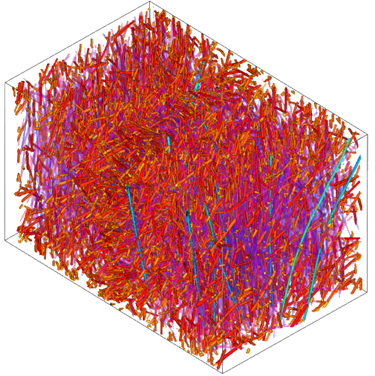
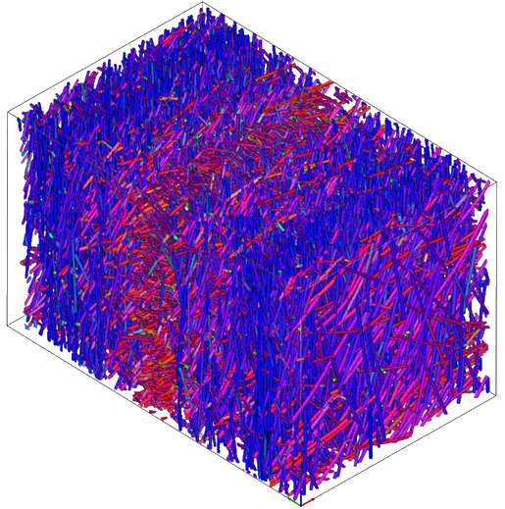
Thank you for your attention!
Johannes Weissenböck
University of Applied Sciences Upper Austria, Wels Campus
Research Group Computed Tomography, www.3dct.at
Johannes.weissenboeck@fh-wels.at
Notes:
…and do not hesitate to ask me any questions.

